Slide 1

Button control Sweep Omibox
Button control Wrestle Omibox
Yahboom

Slide 2
1
2
3
4
5
Learning
goals
Search for
blocks
Combine
blocks
Experimental
phenomena
Preparation
程序编程
Tencent

Slide 3
1
Preparation-1
1. The position of the button in the robot car
2. Learn how to use button graphically programming block

Slide 4
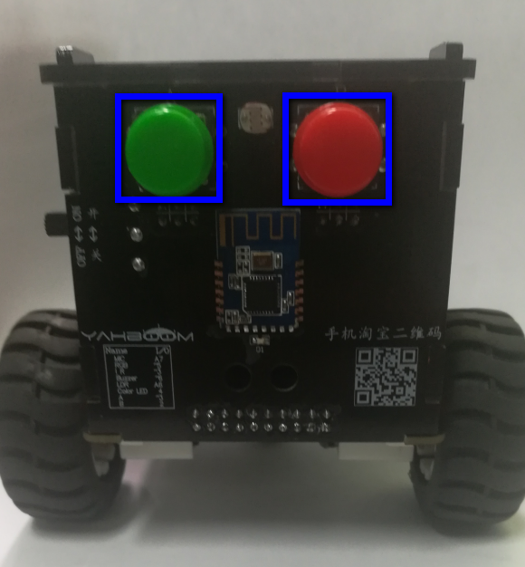
1
Preparation-2
As shown in the figure above,we circled the blue wire frame with two buttons, and we can control them by programming.

Slide 5
2
Learning goals
In this lesson, we will learn how to use the buttons.
When the green button is pressed, Omibox start to attack.
When the green button is not pressed, Omibox retract .

Slide 6
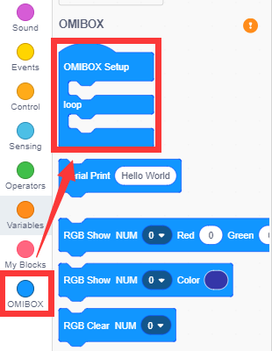
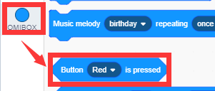
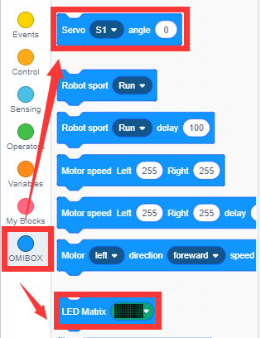
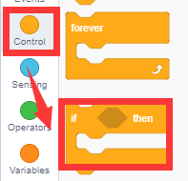
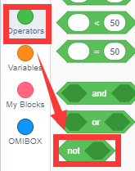
3
Search for blocks
The following is the location of the building blocks required for this programming.

Slide 7
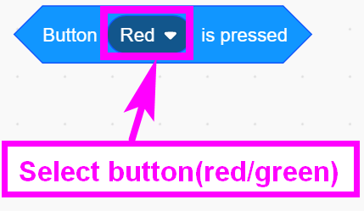
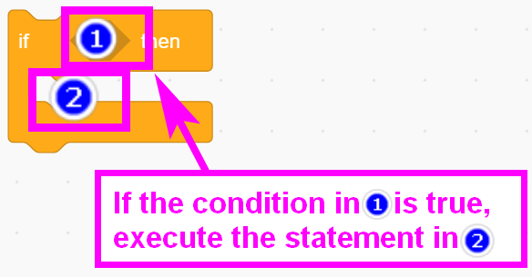
3
Search for blocks

Slide 8
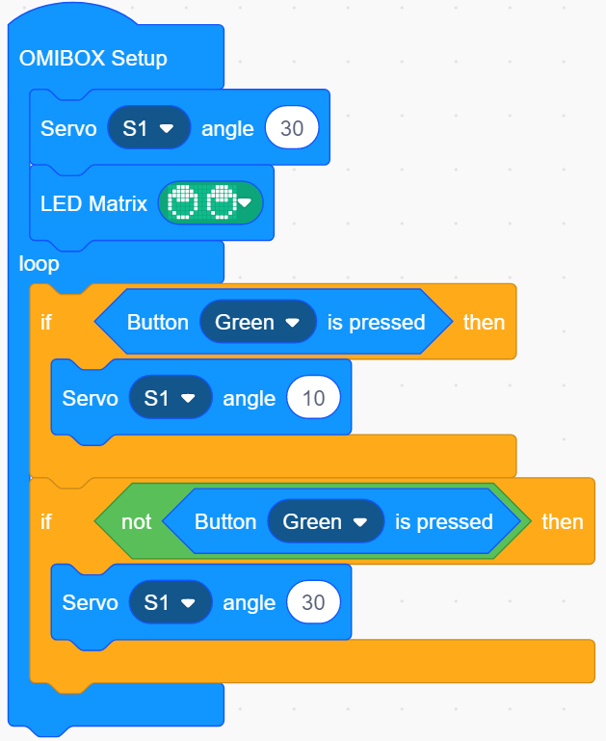
4
Combine blocks
The summary program is shown below:

Slide 9
5
Experimental phenomena
!!!Note: When use servo in the first time,we need to remove the gear on the building block servo and download the program to micro:bit. Next, turn on the power of the robot, wait for the building block servo to turn to the initial position. Then ,turn off the power. Finally, we need to install the gear on the building block servo. In initial status, Sweep is retract.
After the program is uploaded, open the power of Sweep Omibox,
When the green button is pressed, Omibox start to attack.
When the green button is not pressed, Omibox retract .

Slide 10
Inspire Creativity Embrace Innovation
Thank you!!!
Yahboom

